Slide 1
For-loops
Team 3: Mohammed Alfadl, Kristina Posner, Andrew Thiesse, Anoushka Mahar

Slide 2
Overview
For Loop Structure
Flowchart Formats
Practice Examples
Kahoot!

Slide 3
For Loops
The fundamental structure of repetition in programming
Used to repeat the same task for every item
Output can only be seen with print()
Can be included within functions
for (item in list_of_items) {
do_something(item)
}
Notes:
Used to repeat a task until all items that are in a list, vector, dataframe, array are sifted through

Slide 4
Iterating through Element vs. Index
Start
Start
Iterate index i
i = i+1
Iterate index i
i = i+1
Did we reach last element in loop?
Did we reach last index in loop?
No
No
Yes
Yes
End
End

Slide 5
Example 1 (squaring)
for (i in 1:10) {
print(i**2)
}

Slide 6
Output
[1] 1
[1] 4
[1] 9
[1] 16
[1] 25
[1] 36
[1] 49
[1] 64
[1] 81
[1] 100

Slide 7
Example 2 (List)
v <- c()
for (i in 1:10) {
v <- c(v, i**2)
}
print(v)

Slide 8
Output
[1] 1 4 9 16 25 36 49 64 81 100

Slide 9
Nested For Loops
Outer loop calls the inner loop to run
Inner loop is completed, then the outer loop calls inner loop to run again
Outer loop no longer calls inner loop to run, loops completed.
for (item in list_of_items) {
do_something(item)
for (item2 in list_of_items2) {
do_something(with item or item2)
}
}

Slide 10
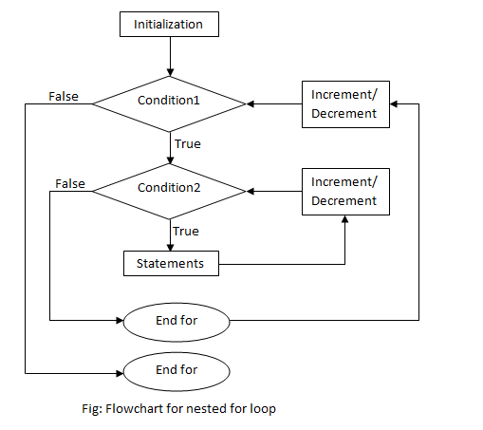

Slide 11
Nested for Loop Example
for (i in 1:4) {
for (j in 1:2) {
print(paste("i = " , i, "; j = ", j))
}
}

Slide 12
Output
[1] "i = 1 ; j = 1"
[1] "i = 1 ; j = 2"
[1] "i = 2 ; j = 1"
[1] "i = 2 ; j = 2"
[1] "i = 3 ; j = 1"
[1] "i = 3 ; j = 2"
[1] "i = 4 ; j = 1"
[1] "i = 4 ; j = 2"

Slide 13


